Slide 1
Machine Learning for data science and business intelligence – 8IAR403
By Kévin Bouchard Ph.D.
Professor in artificial intelligence & machine learning
Laboratoire d'Intelligence Ambiante pour la reconnaissance d'activités (LIARA)
Université du Québec à Chicoutimi
www.Kevin-Bouchard.ca

Slide 2

Summary of lesson #7
You will learn about:
Support vector machine
Non-linearity in a ML algorithm
Kernel trick using radial function basis

Slide 3
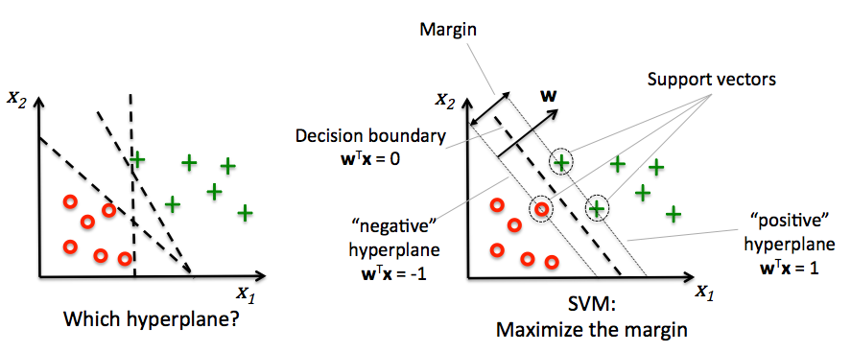
Support Vector Machine
In the Perceptron, we minimize the classification error
In SVM, we rather maximize the margin between classes
Margin: is the distance between and hyperplane and the samples closest to it (support vectors)
It finds the optimal solution!
Notes:
Peut-être considéré comme une extension du perceptron
Très puissant et populaire

Slide 4
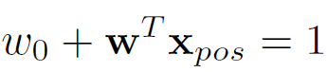
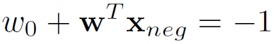
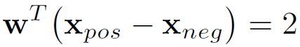
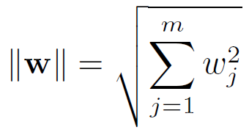
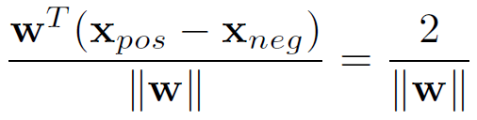
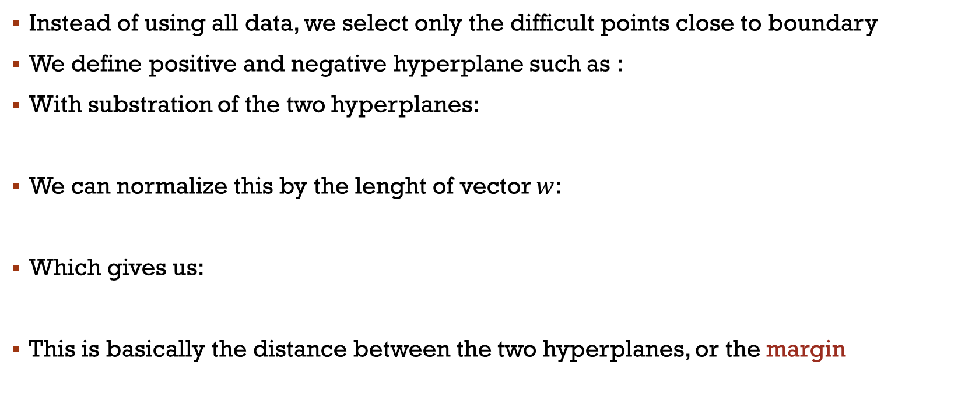
Maximal Margin
Instead of using all data, we select only the difficult points close to boundary
We define positive and negative hyperplane such as :
With substration of the two hyperplanes:
We can normalize this by the lenght of vector $w$:
Which gives us:
This is basically the distance between the two hyperplanes, or the margin

Slide 5
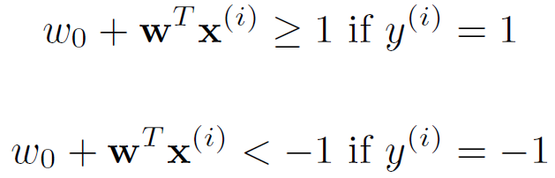

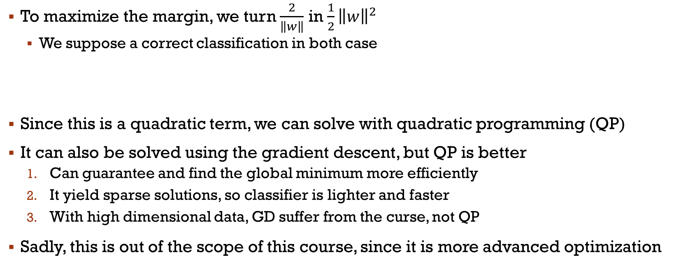
Quadratic programming
To maximize the margin, we turn $\frac{2}{\left\|w\right\|}$ in $\frac{1}{2}{\left\|w\right\|}^{2}$
We suppose a correct classification in both case
Since this is a quadratic term, we can solve with quadratic programming (QP)
It can also be solved using the gradient descent, but QP is better
Can guarantee and find the global minimum more efficiently
It yield sparse solutions, so classifier is lighter and faster
With high dimensional data, GD suffer from the curse, not QP
Sadly, this is out of the scope of this course, since it is more advanced optimization

Slide 6
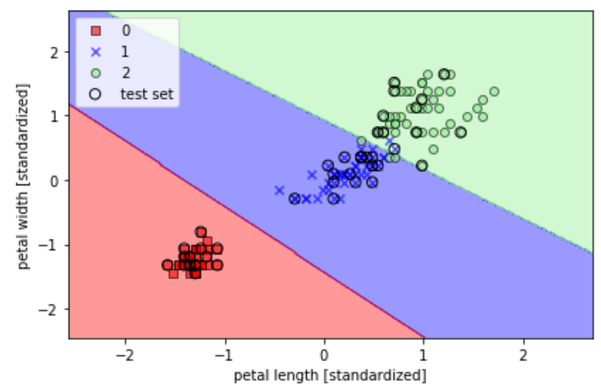
Test of SVM
SVM is easy to use in Scikit
From our previous code, there is only a few changes
from sklearn.svm import SVC svm = SVC(kernel='linear', C=1.0, random_state=0) svm.fit(X_train_std, y_train) plot_decision_regions(X_combined_std, y_combined, classifier=svm, test_idx=
(105, 150)) plt.xlabel('petal length [standardized]') plt.ylabel('petal width [standardized]')
plt.legend(loc='upper left')
plt.tight_layout()
plt.show()

Slide 7

SVM vs Logistic Regression
Give similar results in practice
Logistic: maximizes the conditional probabilities of the samples
More sensitive to outliers
Simpler model
Easier to implement
Easier to update
SVM
Mainly concerned with the samples at the class boundary
Little advantage over logistic regression
Notes:
Pourquoi SVM dans ce cas???

Slide 8
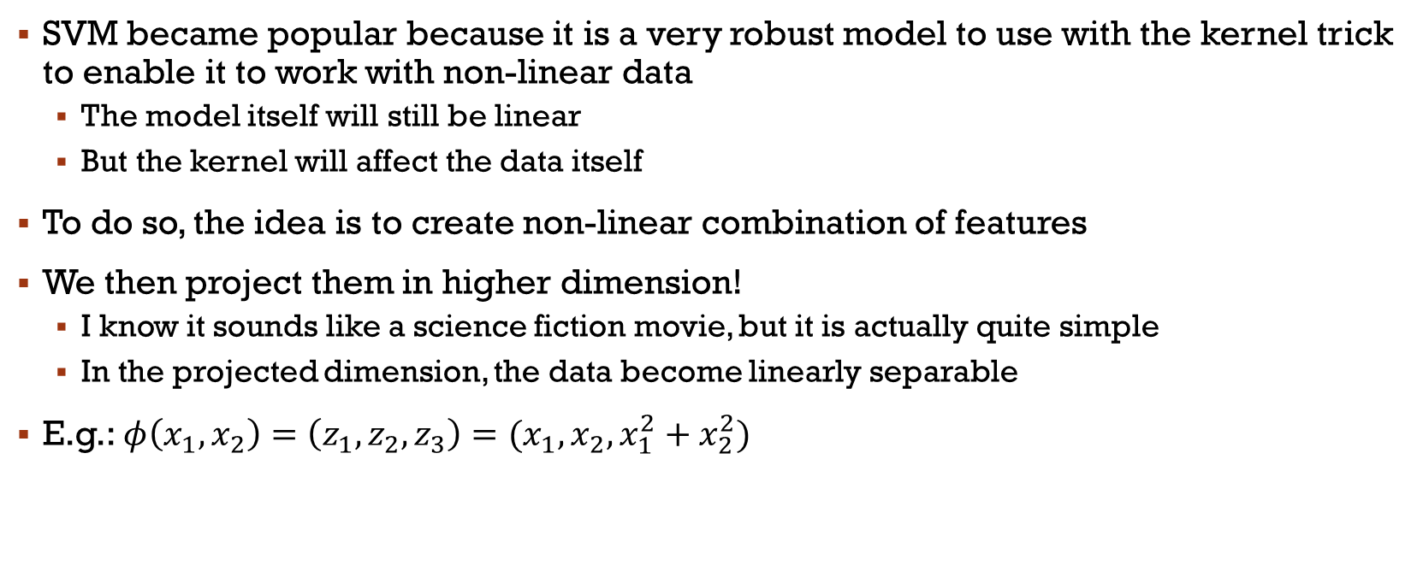
Kernel trick to enable non-linearity
SVM became popular because it is a very robust model to use with the kernel trick to enable it to work with non-linear data
The model itself will still be linear
But the kernel will affect the data itself
To do so, the idea is to create non-linear combination of features
We then project them in higher dimension!
I know it sounds like a science fiction movie, but it is actually quite simple
In the projected dimension, the data become linearly separable
E.g.: $φ\left(x_{1},x_{2}\right)=\left(z_{1},z_{2},z_{3}\right)=(x_{1},x_{2},x_{1}^{2}+x_{2}^{2})$

Slide 9
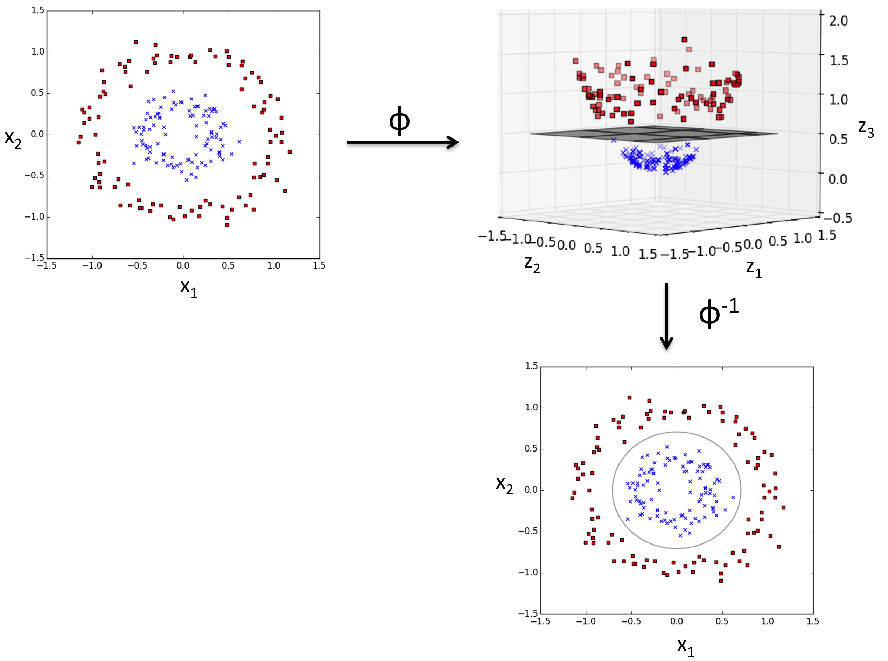

Slide 10

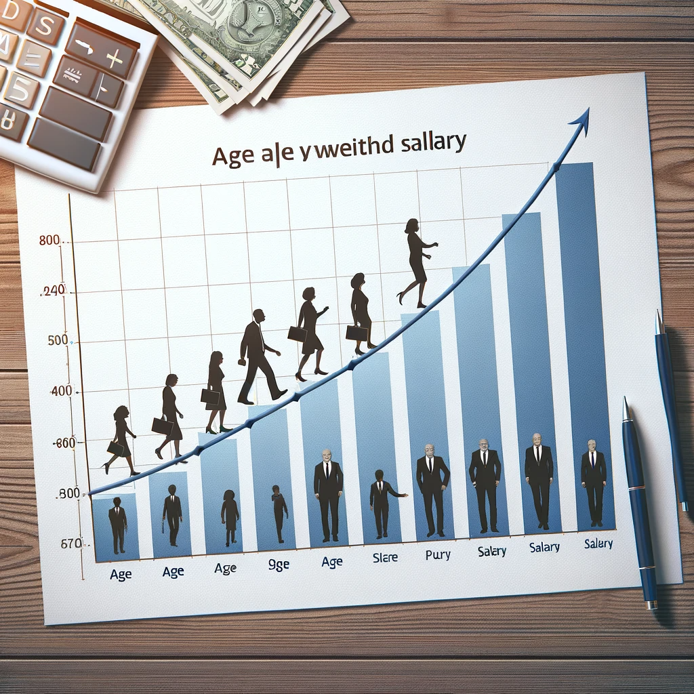

Ok, but Why non-linearity?
We saw that some problem simply cannot be solved using linear models
Indeed, real-world data is rarely linear, and more interesting problems for ML aren’t
For example, the relationship between age and income, could plateau or even decrease after a certain age
Hence, non-linear model can better capture the complexity and interaction between features
It is also more flexible in modeling various types of data distributions

Slide 11
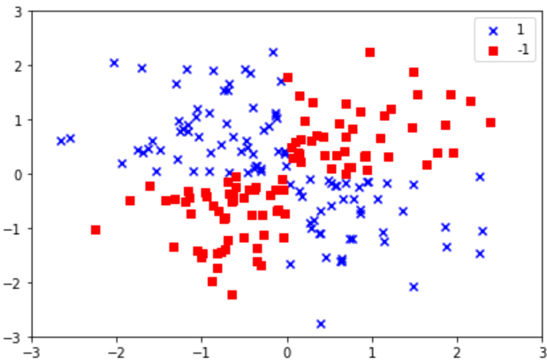
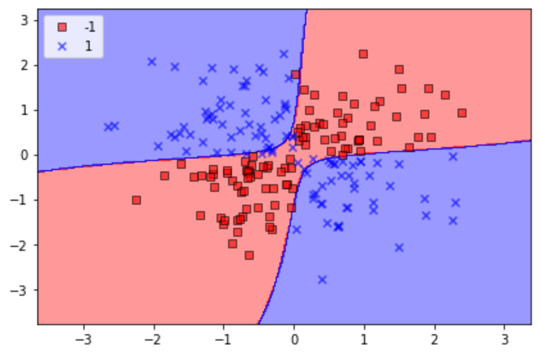
Non-Linear SVM
Let us use this non-linearly separable problem
But how does RBF find out good features to project in higher dimension?
svm = SVC(kernel='rbf', random_state=0, gamma=0.10, C=10.0) svm.fit(X_xor, y_xor) plot_decision_regions(X_xor, y_xor, classifier=svm)
plt.legend(loc='upper left')
plt.tight_layout()
plt.show()

Slide 12
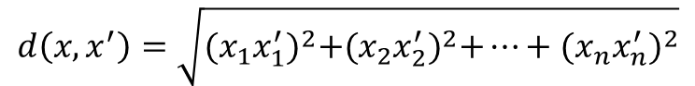
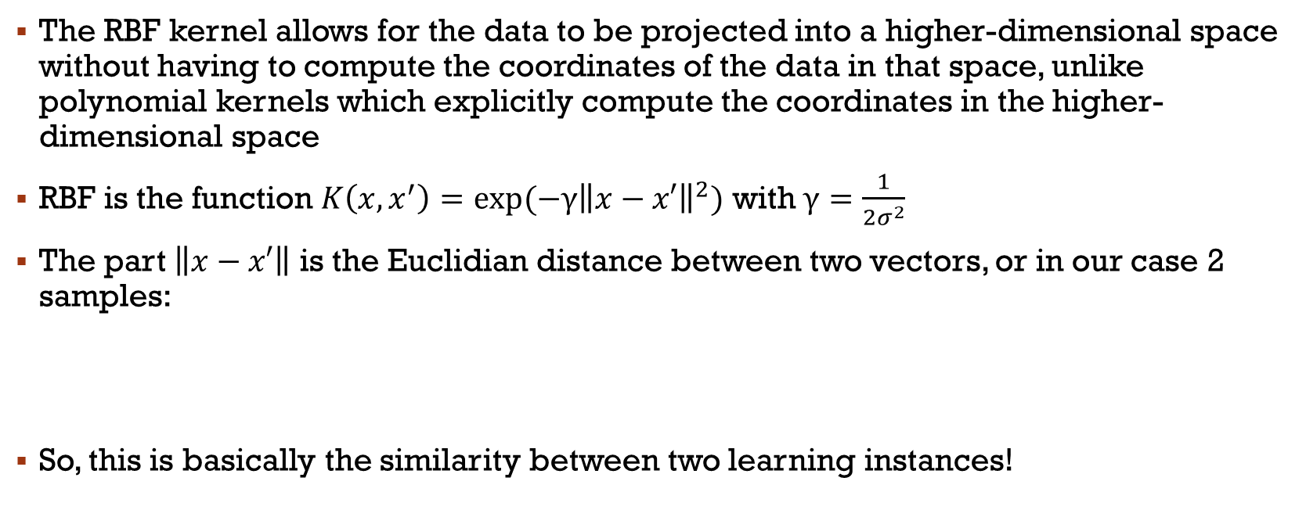
Radial function Basis
The RBF kernel allows for the data to be projected into a higher-dimensional space without having to compute the coordinates of the data in that space, unlike polynomial kernels which explicitly compute the coordinates in the higher-dimensional space
RBF is the function $K\left(x, x^{′}\right)=exp⁡(−{γ\left\|x−x′\right\|}^{2})$ with $γ=\frac{1}{{2σ}^{2}}$
The part $\left\|x−x′\right\|$ is the Euclidian distance between two vectors, or in our case 2 samples:
So, this is basically the similarity between two learning instances!
$$d\left(x, x^{′}\right)=\sqrt{{(x_{1}x_{1}^{′})}^{2}+{(x_{2}x_{2}^{′})}^{2}+…+{(x_{n}x_{n}^{′})}^{2}}$$

Slide 13
Radial function Basis
The RBF kernel, by considering the distance between feature vectors, effectively creates an infinite-dimensional space
The features in the new space correspond to measures of similarity (as determined by the kernel function) between the data points in the original space
γ defines how much influence a single training example has
The larger γ is, the closer other examples must be to be affected

Slide 14
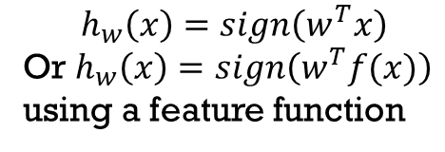

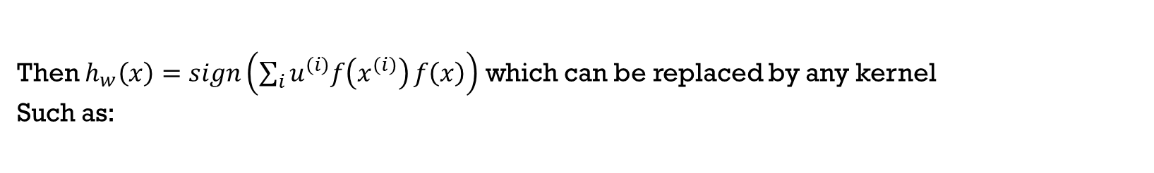
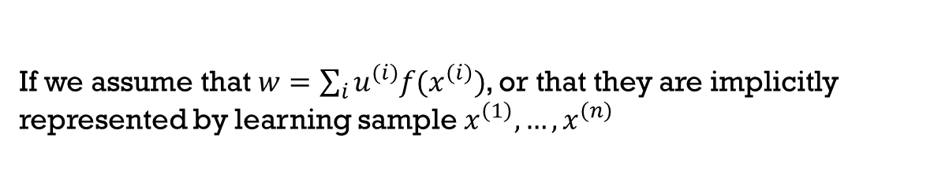
Radial function Basis
Remember that classification on a binary problem is basically the function:
$$h_{w}\left(x\right)=sign\left(w^{T}x\right)$$
Or $h_{w}\left(x\right)=sign\left(w^{T}f(x)\right)$ using a feature function
If we assume that $w=\sum_{i}{u^{\left(i\right)}f(x^{\left(i\right)})}$, or that they are implicitly represented by learning sample $x^{\left(1\right)},…,x^{\left(n\right)}$
Then $h_{w}\left(x\right)=sign\left(\sum_{i}{u^{\left(i\right)}f\left(x^{\left(i\right)}\right)}f\left(x\right)\right)$ which can be replaced by any kernel
Such as:
$$h_{w}\left(x\right)=sign\left(\sum_{i}{u^{\left(i\right)}K\left(x^{\left(i\right)},x\right)}\right)$$
Notes:
Tell them we can actually use the Kernel trick in many algorithms (including Perceptron and Logistic)
Start performing poorly with big data

Slide 15
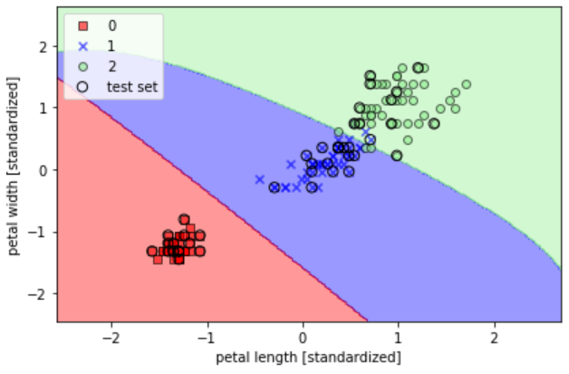
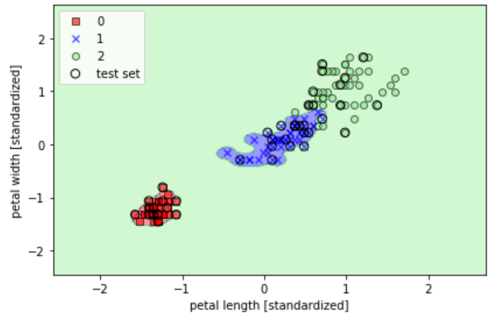
Conclusion on non-linear SVM
We can apply non-linear SVM to the iris data
Here is SVM on Iris with gamma of 0.2 and of 100 (i.e., we usually take small value!)

Slide 16
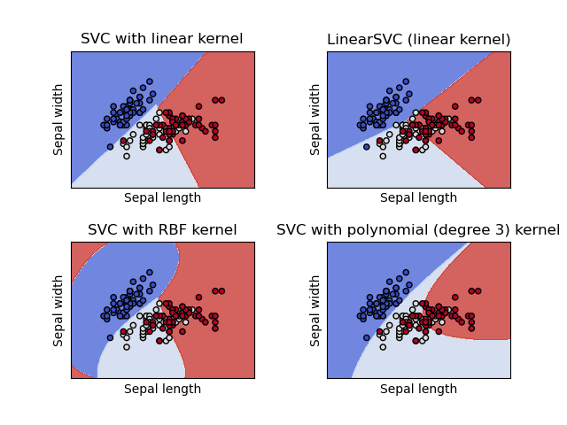
SVM models in Scikit
SVC and NuSVC are similar with only a different mathematical formulation
LinearSVC is faster but linear
SVR, NuSVR, and LinearSVR are the three equivalent classes for regression
We’ll talk about regression in Lesson #8
Notes:
Les différentes implémentations de SVM dans Scikit

Slide 17
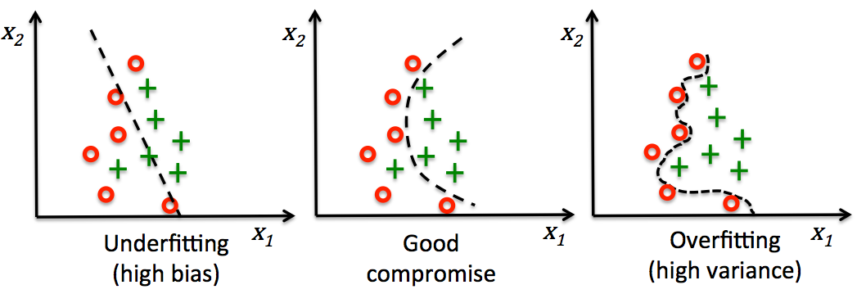
Fitting of a model
However, if we complexify our model, we now have to think about overfitting!
Linear models can only be adequate or underfit, but non-linear models can be anywhere in the spectrum
Notes:
Nos modèles étaient tous linéraires (Percept, Adaline, Logistic Reg)

Slide 18
What is Underfitting?
A model cannot capture the underlying trend of the data
An underfitted model is not complex enough to properly learn from the training data, leading to poor performance both on the training data and on unseen data
The model has high bias
Faster and simpler, but won’t perform well
Causes:
Model is too simple so it can’t capture the complexity of the data
Inadequate learning time (in case of neural network)
Bad dataset to train the model
Solutions:
Increase model complexity, use a non-linear method
Engineer better features that capture more information about the data.
Decrease regularization, if the underfitting is due to too strong regularization (we’ll see later about regularization)

Slide 19
And overfitting?
The model learns the training data too well, including any outliers or noise
Hence, it results in poor generalization in real applications
We talk about high variance because a few changes in the training data results in a very different final model
Causes:
Too many features (high dimensional data) relative to the number of observations
Too complex a model (e.g., deep neural networks or high-degree polynomials in regression)
Inadequate or no regularization or training for too long
Solutions (we’ll see them in later lessons):
Models: simplify the model, prune the trees, and/or introduce regularization
Collect more training data or find a way to increase the dataset
Improve the training methodology (K-fold, LOSO, etc.)

Slide 20
Bias-Variance tradeoff
From that arise what we call the bias-variance tradeoff in ML
The tradeoff is that you can typically reduce bias by making your model more complex, but this tends to increase variance and the risk of overfitting
Ideally, you want a model that accurately captures the regularities in its training data, but that also generalizes well to unseen data
This balance can often be achieved through proper model selection, the use of validation techniques, and tuning of model hyperparameters
Often, the configuration of the algorithms help working on the balance
E.g.: In KNN, a bigger k (main hyperparameter) increase bias
E.g.: In logistic regression, the c parameter is for regularization (bigger c results in + bias, but – variance)
Same for SVM and many other methods

Slide 21
Main References
Russell S., Norvig P., Artificial Intelligence: A Modern Approach. Prentice-Hall, Englewood Cliffs, 2021.
Aggarwal, C. C., Neural networks and deep learning. Springer, 2023.
Goodfellow I., Bengio Y., Deep Learning. The MIT Press, 2016.
Raschka S., Python Machine Learning, Packt Publishing, 2015.
Sutton R.S., Barto A.G., Reinforcement Learning: An Introduction, A Bradford Book, 2021.
Witten I.H., Frank E., Hall M.A., Pal C. Data Mining: Practical Machine Learning Tools and Techniques, Morgan Kaufmann, 2016.

